Slide 1
Programming for Engineers in Python
Week 11: NumPy and
Image Processing
Fall 2019-2020

Slide 2

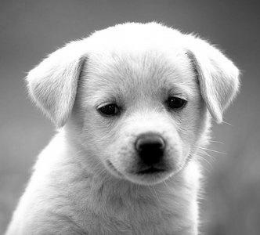
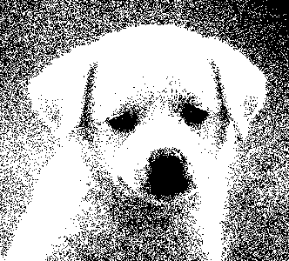
Today
Basics of :
NumPy
SciPy
Image Processing

Slide 3
NumPy and SciPy
NumPy and SciPy are packages for scientific computing that provide fast pre-compiled mathematical and numerical functions.
The NumPy (Numeric Python) package provides basic routines for manipulating large arrays and matrices of numeric data.
Free Matlab alternative
The SciPy (Scientific Python) package extends the functionality of NumPy with a large collection of useful algorithms, like minimization, regression, and other applied mathematical techniques.

Slide 4
NumPy and SciPy
NumPy and SciPy are open-source, and therefore provide a free Matlab alternative.
The packages are popular among scientists, researchers and engineers who want to apply various mathematical methods on large datasets.
Read more here: http://docs.scipy.org/doc/numpy/reference/

Slide 5
Importing the required modules
The packages we need are already included within the installation of Anaconda.
Make sure you import any needed package at the beginning of your program in order to use its classes….
For example:
import numpy as np, matplotlib, scipy
Alias

Slide 6
NumPy’s main object is the Array
NumPy’s main object is the homogeneous multidimensional array.
It is a table of elements (usually numbers), all of the same type, indexed by a tuple of positive integers.
In Numpy dimensions are called axes.
The number of axes is rank (the number of array’s dimensions).
A vector is an array of rank 1
A 2D matrix is an array of rank 2.

Slide 7
The Array object - Creation
>>> import numpy as np
>>> a = np.array([0, 1, 2])
# 1D array of size 3
>>> a
array([0, 1, 2])
>>> b = np.array([[0, 1, 2], [3, 4, 5]])
# 2D array of size 2 x 3
>>> b
array([[0, 1, 2],
[3, 4, 5]])
2 | 1 | 0
2 | 1 | 0
5 | 4 | 3

Slide 8
Array – Attributes & Methods
>>> b = np.array([[0, 1, 2], [3, 4, 5]])
# creates a 2 x 3 array
>>> b
array([[0, 1, 2],
[3, 4, 5]])
>>> b.ndim
# number of dimensions
2
>>> b.shape # dimension sizes
(2, 3)
>>> len(b) # returns the size of the first dimension
2
>>> b.T # Transpose
array([[0, 3],
[1, 4],
[2, 5]])
2 | 1 | 0
5 | 4 | 3
3 | 0
4 | 1
5 | 2

Slide 9
Creating an array of zeros or ones
>>> np.zeros(7, dtype=int)
array([0, 0, 0, 0, 0, 0, 0])
>>> np.ones((2,3), dtype=float)
array([[1., 1., 1.],
[1., 1., 1.]])

Slide 10
Creating arrays containing number sequences
Like range in Python, but returns a numpy array object
>>> np.arange(10)
array([0, 1, 2, 3, 4, 5, 6, 7, 8, 9])
>>> np.arange(2,7)
array([2, 3, 4, 5, 6])
>>> np.arange(2,7,2)
# start, end (exclusive), step
array([2, 4, 6])

Slide 11
Creating arrays containing number sequences
>>> print(np.arange(1, 5.5, 0.5))
# start, end (exclusive), step
[1. 1.5 2. 2.5 3. 3.5 4. 4.5 5. ]
# slicing is similar to standard lists
>>> print(np.arange(1, 5.5, 0.5)[3:1:-1])
[2.5 2. ]
# start, end, number of points
>>> print(np.linspace(1, 5, 9))
[1. 1.5 2. 2.5 3. 3.5 4. 4.5 5. ]
# Arrays with random values between 0 and 1
>>> print(np.random.random(5))
[0.16857547 0.31380802 0.00347811 0.87055124 0.23589622]
Additional ways to create arrays in NumPy:
http://docs.scipy.org/doc/numpy-1.10.1/reference/routines.array-creation.html#routines-array-creation

Slide 12
Indexing and slicing: similar to lists
>>> a = np.diag(np.arange(3))
array([[0, 0, 0],
[0, 1, 0],
[0, 0, 2]])
>>> a[1, 1]
1
>>> a[2, 1] = 10
>>> a[1, :] # a[1] also works
array([0, 1, 0])
>>> a[:,1]
array([ 0, 1, 10])
>>> a[2, 1:]
array([10, 2])
Slicing: specify which rows/columns
to take by
A[rows, columns]

Slide 13
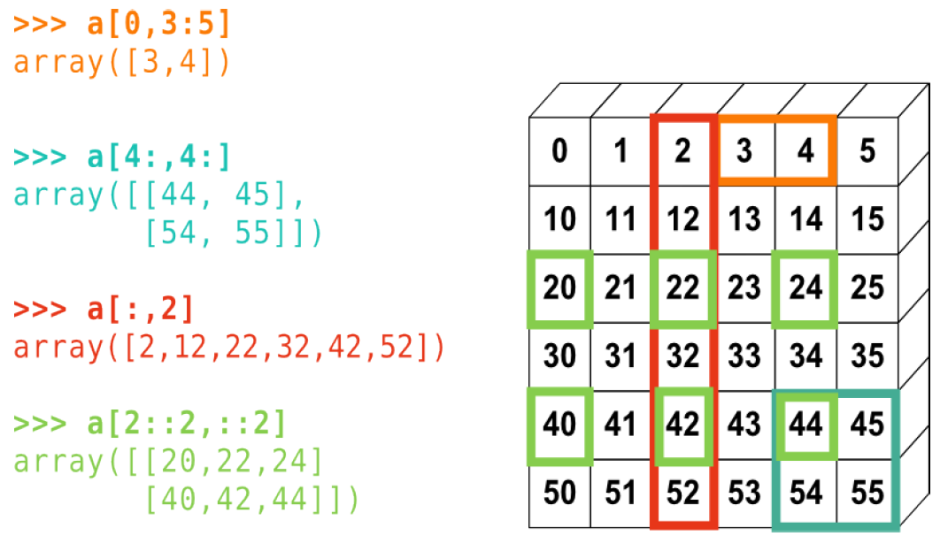
Indexing and slicing: matrices

Slide 14
Reshaping an Array
>>> a
array([0., 1., 2., 3., 4., 5., 6., 7., 8., 9.])
>>> a = a.reshape((5, 2))
>>> a
array([[0., 1.],
[2., 3.],
[4., 5.],
[6., 7.],
[8., 9.]])
>>> a.shape
(5, 2)
9. | 8. | 7. | 6. | 5. | 4. | 3. | 2. | 1. | 0.
Reshape
Creates a new array
1. | 0.
3. | 2.
5. | 4.
7. | 6.
9. | 8.

Slide 15
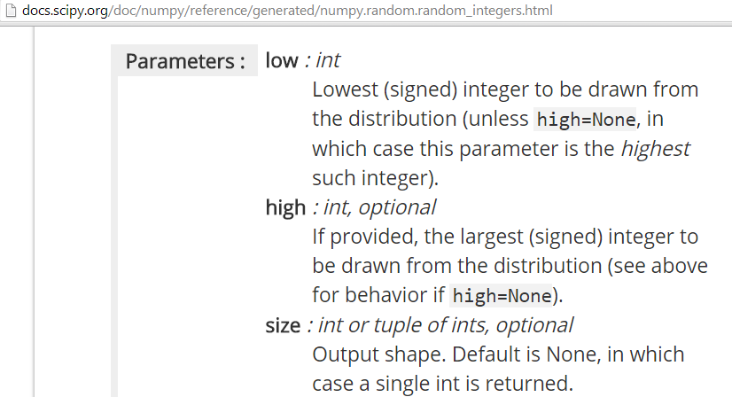
Comparisons and Boolean operations
>>> a = np.random.random_integers(0, 10, 15)
array([ 4, 9, 1, 7, 0, 9, 8, 10, 1, 0, 7, 7, 9, 5, 1])
Documentation - search np.random.random_integers in google

Slide 16
Comparisons and Boolean operations
>>> a = np.random.random_integers(0, 10, 15)
>>> a
array([0, 9, 5, 3, 10, 10, 8, 4, 1, 5, 1, 6, 5, 10, 5])
>>> b = np.arange(15)
array([0, 1, 2, 3, 4, 5, 6, 7, 8, 9, 10, 11, 12, 13, 14])
>>> comp1 = a==b
>>> comp1
array([ True, False, False, True, False, False, False, False, False,
False, False, False, False, False, False])
>>> comp1.any()
True
>>> comp1.all()
False
>>> comp1.nonzero()
(array([0, 3], dtype=int64),)
>>> comp1.sum()
2
# array of Booleans, elementwise comparison
Any is true?
Are all true?
Get the True indices
How many TRUEs are in comp1?

Slide 17
Fancy indexing: Logical indexing
>>> a = np.random.random_integers(0, 20, 15)
>>> a
array([10, 3, 8, 0, 19, 10, 11, 9, 10, 6, 0, 20, 12, 7, 14])
>>> (a % 3 == 0)
What will be the result?
What will be the type of the new object?
array([False, True, False, True, False, False, False, True, False,True, True, False, True, False, False])

Slide 18
Fancy indexing: Logical indexing
>>> a = np.random.random_integers(0, 20, 15)
>>> a
array([10, 3, 8, 0, 19, 10, 11, 9, 10, 6, 0, 20, 12, 7, 14])
>>> (a % 3 == 0)
array([False, True, False, True, False, False, False, True, False, True, True, False, True, False, False])
>>> mask = (a % 3 == 0)
# extract sub-array: this is a copy!
>>> extract_from_a = a[mask]

Slide 19
Fancy indexing: Logical indexing
>>> a = np.random.random_integers(0, 20, 15)
>>> a
array([10, 3, 8, 0, 19, 10, 11, 9, 10, 6, 0, 20, 12, 7, 14])
>>> (a % 3 == 0)
array([False, True, False, True, False, False, False, True, False,True, True, False, True, False, False])
>>> mask = (a % 3 == 0)
# extract sub-array: this is a copy!
>>> extract_from_a = a[mask]
>>> extract_from_a
array([ 3, 0, 9, 6, 0, 12])
# change sub-array
>>> a[mask] = -1
>>> a
array([10, -1, 8, -1, 19, 10, 11, -1, 10, -1, -1, 20, -1, 7, 14])

Slide 20
Fancy indexing II
# Indexing with array/list of integers
>>> a = np.arange(0, 100, 10)
array([ 0, 10, 20, 30, 40, 50, 60, 70, 80, 90])
>>> a[[2, 3, 2, 4, 2]]
# note: [2, 3, 2, 4, 2] is a list
array([20, 30, 20, 40, 20])

Slide 21
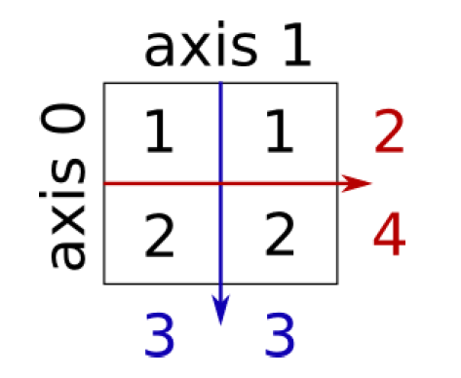
Reductions
>>> x = np.array([[1, 1], [2, 2]])
>>> x
array([[1, 1],
[2, 2]])
>>> x.sum() # works on the entire matrix
6
>>> x.sum(axis=0) # sum the columns along axis 0
array([3, 3])
>>> x[:, 0].sum(), x[:, 1].sum()
(3, 3)
>>> x.sum(axis=1) # sum the rows along axis 1
array([2, 4])
>>> x[0, :].sum(), x[1, :].sum()
(2, 4)
Also works with x.min, x.max, x.mean etc.

Slide 22
Sorting along an axis
>>> a = np.array([[4, 3, 5], [1, 2, 1]])
>>> b = np.sort(a, axis=1)
>>> b
array([[3, 4, 5],
[1, 1, 2]])
>>> a.sort(axis=1)
>>> a
array([[3, 4, 5],
[1, 1, 2]])

Slide 23
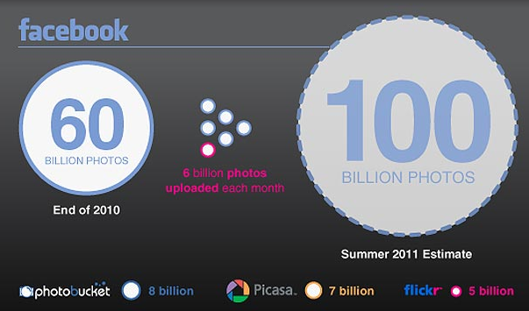
Application: image processing
Digital image is a numeric representation of a two-dimensional image
Examples photos, microscopic, medical, astronomical
23
Notes:
23

Slide 24
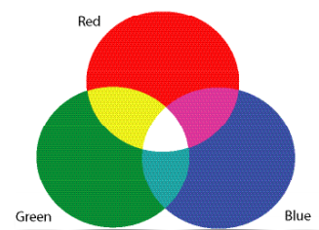
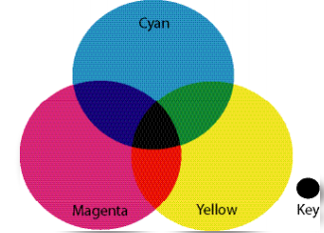
Image Representation
Encoded as a n-by-m matrix M
Pixel Each element M[x,y] in an image is called picture element (pixel), representing the light intensity / color at that location
RGB / gray-level images
Video – an image for each time t
http://www.youtube.com/watch?v=bgtHKR0aQpQ
24
Notes:
24

Slide 25
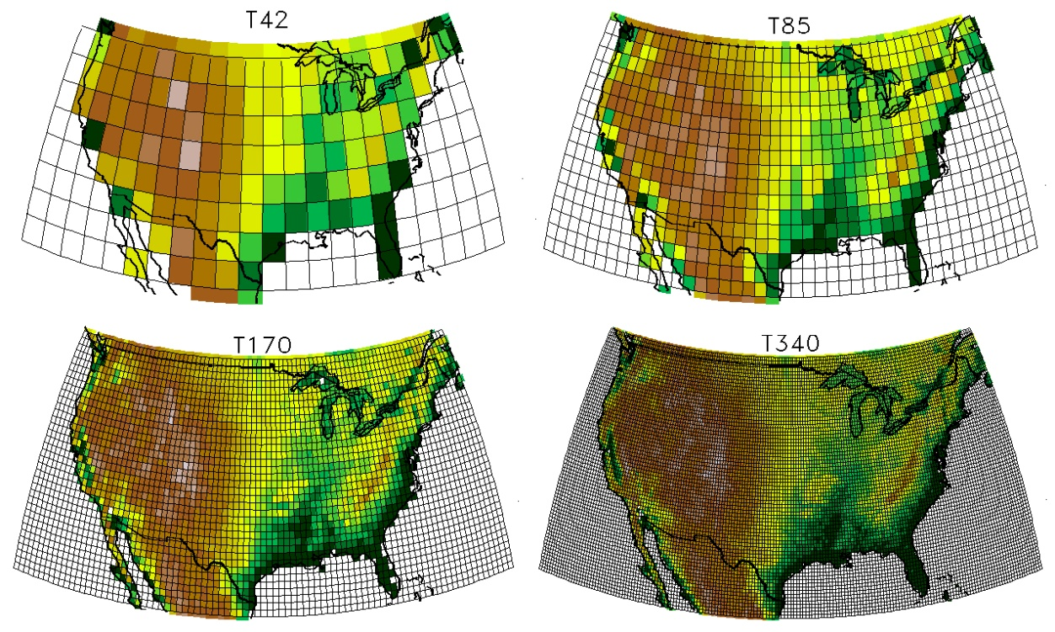
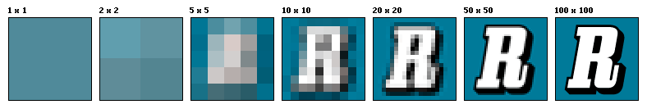
Resolution
Pixel resolution == pixel count
25
Notes:
25

Slide 26
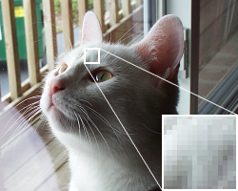
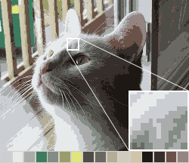
Image Quantization
Number of bits per pixel
24 bit RGB
16 colors
Note that both images have the same pixel & spatial resolution
Notes:
26

Slide 27
Gray Level Images
Most of class will deal with gray-level images (although can be applicable for color images)
8 bits per pixel (256 gray levels), 0 – black, 255 – white
Other representations:
Binary – 1bit per pixel
Some applications use more colors (medical imaging)
27
Notes:
27

Slide 28
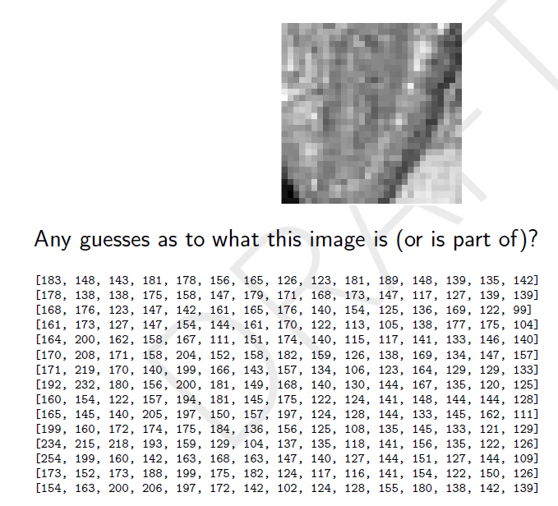
An Example
28
Notes:
28

Slide 29
Image Processing
Typical operations:
Color corrections / calibration
Image segmentation
Image registration / alignment
Denoising
Typical applications:
Machine vision
Medical image processing
Face detection
Augmented reality
29
Notes:
29

Slide 30
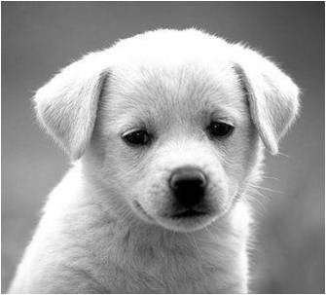
Loading and Viewing an Image
>>> import matplotlib.pyplot as plt
>>> import imageio
>>> im = imageio.imread(‘puppy1.jpg’)
>>> type(im)
<type 'numpy.ndarray'>
>>> im[:5,:5]
array([[255, 231, 255, 250, 251],
[232, 102, 88, 71, 94],
[255, 98, 85, 86, 94],
[245, 79, 94, 104, 85],
[255, 87, 89, 90, 75]], dtype=uint8)
30
Notes:
30

Slide 31
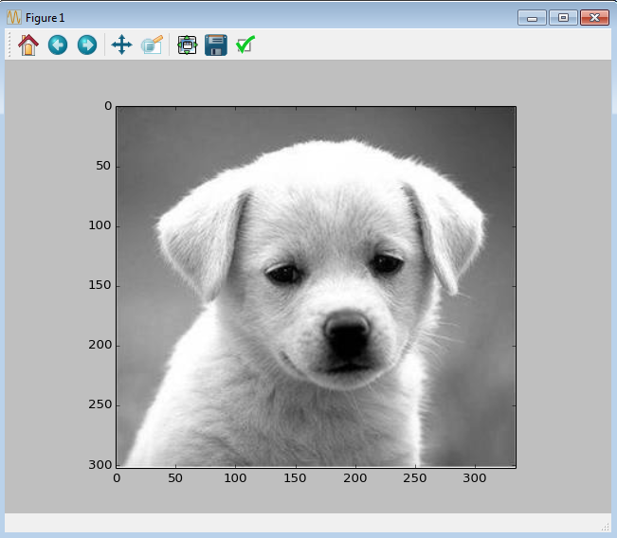
Loading and Viewing an Image
>>> import matplotlib.pyplot as plt
>>> import imageio
>>> im = imageio.imread(‘puppy1.jpg’)
>>> type(im)
<type 'numpy.ndarray'>
>>> im.shape, im.dtype
((256L, 256L), dtype('uint8'))
>>> np.min(im), np.max(im)
(3, 238)
>>> plt.figure()
>>> plt.imshow(im)
31
Notes:
31

Slide 32
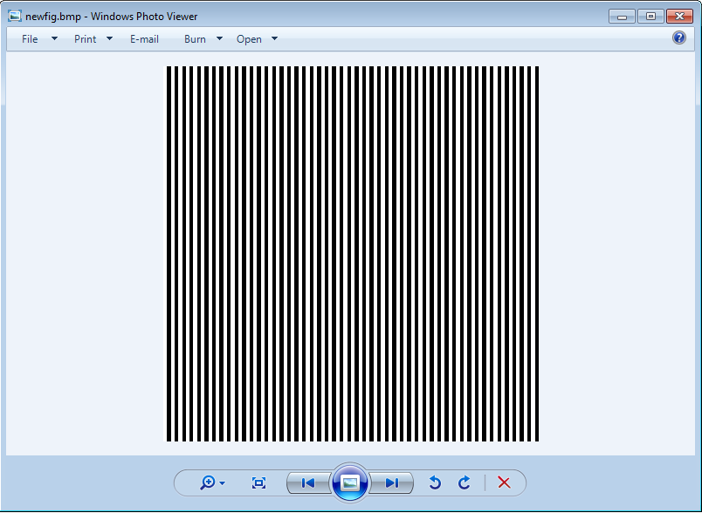
Create and Save an Image
# create and save an image of vertical lines
new_fig = np.zeros((100,100))
new_fig[:,::2] = 255
plt.figure()
plt.imshow(new_fig, cmap=plt.cm.gray)
# save image as a new file
imageio.imwrite('newfig.bmp’, new_fig)
Output
32
Notes:
32

Slide 33
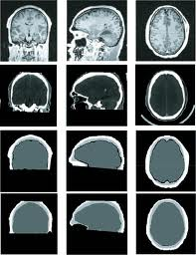
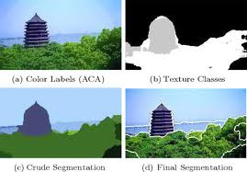
Thresholding
Simplest segmentation method
Apply a threshold to turn a gray-scale image into a binary image
The key is to select the appropriate threshold value
Popular method – Otsu’s method (maximal variance)
33
Notes:
33

Slide 34
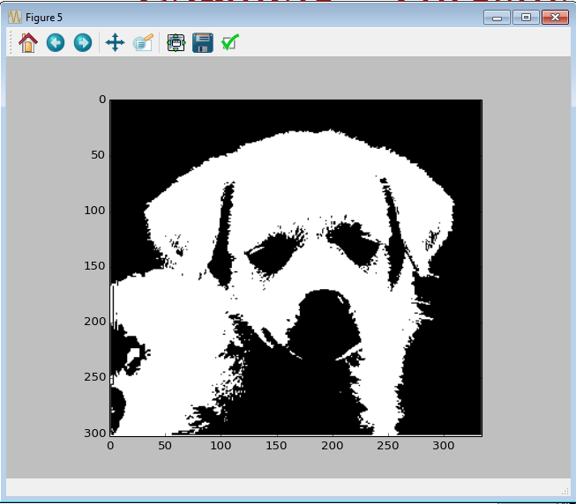
Example - Thresholding
# thresholding def segment_image(im_mat, th) : new_mat = np.zeros(im_mat.shape) new_mat[im_mat >= th] = 255 return new_mat
new_mat = im > th
Also works!
im = imageio.imread(‘puppy1.jpg’)
new_image = segment_image(im, 150) plt.figure() plt.imshow(new_image, cmap=plt.cm.gray (
plt.show()
34
Notes:
34

Slide 35
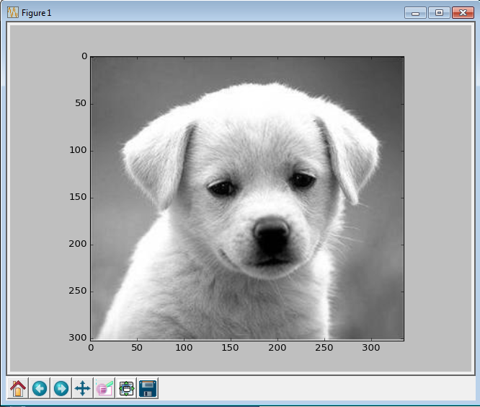
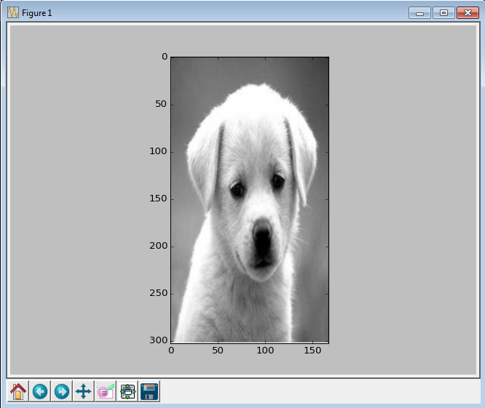
Additional example
If time permits...
Squeeze an image

Slide 36
Squeeze!
Input: an image m and a factor k (integer)
Create a new image
A column in the new image = the mean of k columns

Slide 37
Squeeze!
Input: an image m and a factor k (integer)
Create a new image
A column in the new image = the mean of k columns
8 | 6 | 12 | 10
7 | 2 | 4 | 0
2 | 1 | 1 | 1
10 | 8 | 6 | 4
7 | 11
5 | 2
1 | 1
9 | 7

Slide 38
Squeeze code
def squeeze_image(im,factor): new_n = im.shape[0] new_m = im.shape[1] // factor new_mat = np.zeros((new_n,new_m)) for j in range(new_mat.shape[1]): curr_range = range(j*factor,min((j+1)*factor,im.shape[1])) new_mat[:,j] = im[:,curr_range].mean(axis=1) return new_mat

Slide 39
Squeeze code
im = imageio.imread('puppy1.jpg') new_image = squeeze_image(im,1) plt.figure() plt.imshow(new_image, cmap=plt.cm.gray) plt.show() im = imageio.imread('puppy1.jpg') new_image = squeeze_image(im,2) plt.figure() plt.imshow(new_image, cmap=plt.cm.gray) plt.show()

